Slide 1

Progressive Education Society’s Modern College of Engineering, Shivajinagar, Pune-5. Department of Electronics and Telecommunication Engineering, (Program: ENTC) 2024-25
Project title: Automation in MPU Sensor Testing
Names of the students
Aditya Khode
Somesh Mutha
Soham Naik
Sponsored By: Twintech Control Systems Pvt. Ltd.
Name of The Guide : Mrs. Hemlata Nawale

Slide 2
Overview :
Introduction
Literature Survey (Market, Literature, Technological and Research Survey)
System Specifications
Block Diagram
Hardware Design (including PCB Design)
Software Design (Flowchart or Algorithm)
Result (Photo / Audio-Visual / Video Results)
Applications
Future Scope
Conclusion
References

Slide 3
Introduction:
An innovative tool designed to analyze the key parameters of electric motors with precision and efficiency.
In today's rapidly evolving industrial landscape, understanding the performance characteristics of motors is essential for optimizing operational efficiency and ensuring equipment longevity.
By simply placing the MPU sensor near the shaft of a motor and initiating rotation, the sensor empowers users with comprehensive insights into motor performance, facilitating informed decision-making and proactive maintenance strategies.
Our device offers a solution by providing real-time insights into crucial sensor parameters such as Voltage, Frequency, and Resistance.

Slide 4
Literature Survey
The testing and validation of magnetic pick-up sensors are critical to ensure their performance in high-precision applications. Traditional sensor testing methodologies often rely on manual, step-by-step procedures that assess parameters such as sensitivity, voltage output, and frequency response. However, these processes are not only time-consuming but also susceptible to operator-induced errors, which may lead to inconsistencies in testing quality. The proposed solution has been derived from the findings of the following research papers which has proved helpful to achieve the proposed objectives of the project.

Slide 5
Literature Review:
Sr. No. | Year of Publication | Title and Name of Authors’ | Main Findings | Methodology | Limitations/Gap
1. | 2018 | Title: Active Guarded Wheatstone Bridge for High Resistance Measurements Up to 100 TΩ at TÜBİTAK UME. Authors: Ömer Erkan; Gülay Gülmez; Enis Turhan; Cem Hayirli | Developed a high-precision Wheatstone Bridge system for measuring resistances from 100 MΩ to 100 TΩ at up to 1000 V, with improved accuracy using guarded boxes and low-noise cables. | Used an active Wheatstone Bridge with shielded enclosures and low-noise wiring to minimize leakage and noise during high-resistance measurements. | System requires controlled lab conditions and lacks automation or portable application, limiting real-world usability.
2. | 2018 | Title: A self-heated double Wheatstone bridge configuration for a 2-D wind sensor. Authors: Shixuan Gao, Zhenxiang Yi, Yizhou Ye, Ming Qin and Qing-An Huang | Proposed a self-heated double Wheatstone bridge wind sensor using eight thermistors arranged orthogonally to measure 2D wind direction and speed without a central heater. | Used two orthogonal Wheatstone bridges, each formed by four thermistors, where self-heating of the thermistors eliminates the need for an external heating element. | The design may face temperature drift issues and sensitivity limitations under varying environmental conditions.

Slide 6
Summary of Literature Survey
The reviewed literature reveals several gaps and limitations across various studies. For the MPU sensor testing, the system requires controlled lab environments and lacks automation for large-scale testing. The 2D wind sensor design doesn't fully address temperature drift and environmental sensitivity issues. The TMR magnetic sensor benefits from simplified fabrication but needs cost-efficiency optimization and further exploration into environmental stability. The high DC voltage divider study lacks real-world validation and in-depth analysis of long-term stability. While the adaptive power transistor driver test chip shows promise, its real-world performance and integration challenges with large-scale power supplies remain unexplored. Lastly, the smart mosque display system fails to consider its scalability and integration with existing mosque technologies. These gaps highlight the need for further development, particularly in terms of real-world applicability, scalability, and long-term performance.

Slide 7
Market Survey:
The Automation in MPU Sensor Testing project addresses the limitations of manual testing, which is prone to human errors and inconsistencies. By automating the testing process, it ensures more accurate, reliable, and faster results, reducing labor costs. This automation is crucial for industries like automotive, manufacturing, and robotics, where precise sensor performance is essential. As Industry 4.0 and IoT-driven systems grow, automated testing will become standard, enhancing efficiency and expanding market opportunities.

Slide 8
Component Survey:
Magnetic Pickup Sensors Widely used in automotive and industrial applications for speed and position sensing. Available from brands like Honeywell, Denso, and Siemens. Prices range from ₹200 to ₹1000+ depending on specs.
ADS1115 ADC Module Popular for precision analog-to-digital conversion in hobby and industrial projects. Available from Adafruit, Waveshare, etc. Average cost: ₹150–₹300.
Arduino Nano Low-cost microcontroller ideal for compact embedded systems. Compatible clones start at ₹250, while originals are priced around ₹1200.
Raspberry Pi (e.g., Pi 4 Model B) Used for data processing, GUI control, and IoT integration. In high demand due to versatility. Prices vary from ₹3500 to ₹7000+ based on model and specs.
Touch Screen Display (LCD - 3.5” to 7”) Used for real-time GUI interfaces. Common in DIY and industrial systems. Price ranges from ₹800 to ₹3000, depending on size and resolution.

Slide 9
Overall Summary:
The automation of MPU sensor testing streamlines the traditionally manual and error-prone process of evaluating electrical parameters such as voltage, resistance, and frequency. By integrating components like magnetic pickup sensors, ADS1115 ADC, Arduino Nano, Raspberry Pi, and a touchscreen display, the system enables precise, real-time data acquisition, processing, and user-friendly interaction. This automated setup improves accuracy, efficiency, and repeatability, making it suitable for both lab-scale research and potential industrial applications. The solution reduces human intervention, supports data logging, and enables scalable testing workflows — marking a significant step forward in sensor diagnostics and smart testing systems.

Slide 10
Motivation:
Manual testing of magnetic pickup (MPU) sensors is often time-consuming, inconsistent, and prone to human error, especially when dealing with high-frequency or precision-based measurements. With increasing demand for efficient, accurate, and scalable sensor testing in automotive, industrial, and research domains, there is a clear need for an automated solution. This project is driven by the goal to simplify and speed up the MPU sensor testing process using modern embedded systems, enabling real-time analysis, data logging, and interactive visualization. By bridging hardware precision with software intelligence, the system empowers users with a reliable and user-friendly testing tool that enhances productivity and ensures consistent results.

Slide 11
Problem Statement:
Manual MPU sensor testing is slow, error-prone, and lacks real-time analysis. There is a need for an automated system to improve accuracy, efficiency, and user accessibility in sensor evaluation.
Goals and Objectives:
Automate the MPU sensor testing process to reduce manual effort and improve accuracy.
Acquire and convert analog signals using ADS1115 and Arduino Nano for real-time data processing.
Implement a user-friendly interface via Raspberry Pi and touchscreen for live monitoring and control.
Enable data logging and visualization to support analysis, calibration, and consistent sensor evaluation.

Slide 12
System Specifications:
Arduino Nano (Key Specs)
Microcontroller: ATmega328P
Operating Voltage: 5V
I/O Pins: 14 Digital (6 PWM), 8 Analog
Clock Speed: 16 MHz
Memory: 32 KB Flash, 2 KB SRAM, 1 KB EEPROM
Size & Weight: 45mm × 18mm, 7g. 2. Raspberry Pi 4 Model B (Key Specs)
Processor: Quad-core Cortex-A72 @ 1.5GHz
RAM Options: 2GB / 4GB / 8GB LPDDR4
Connectivity: Wi-Fi, Bluetooth 5.0, Gigabit Ethernet
Ports: 2 × USB 3.0, 2 × USB 2.0, 2 × micro-HDMI (up to 4K)
Storage: MicroSD card slot
GPIO: 40-pin header
Power Input: 5V via USB-C (3A recommended)
Size & Weight: 85mm × 56mm × 17mm, 45g

Slide 13
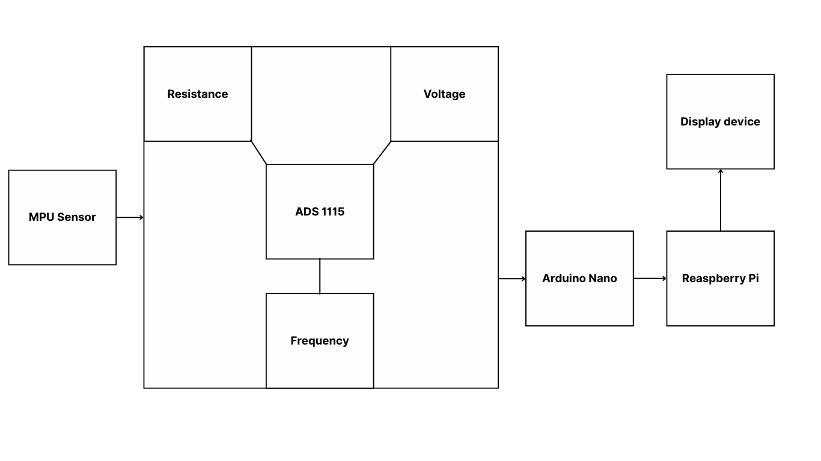
Block Diagram:
Desktop
/

Slide 14
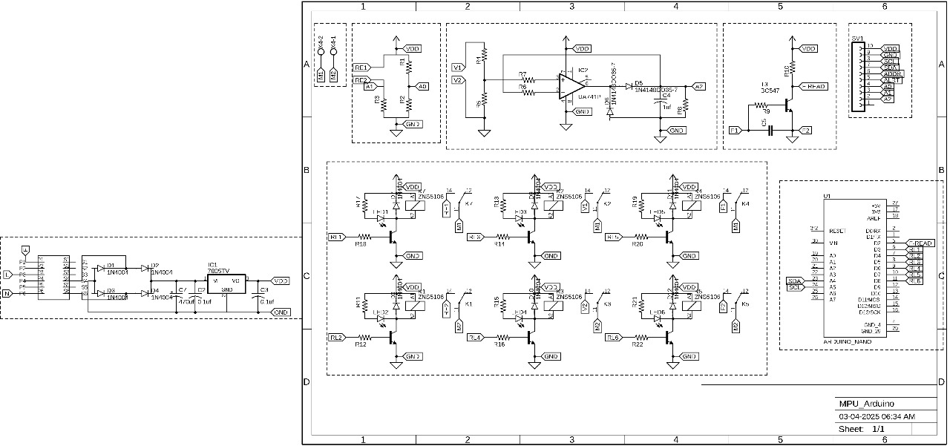
Hardware Design:

Slide 15
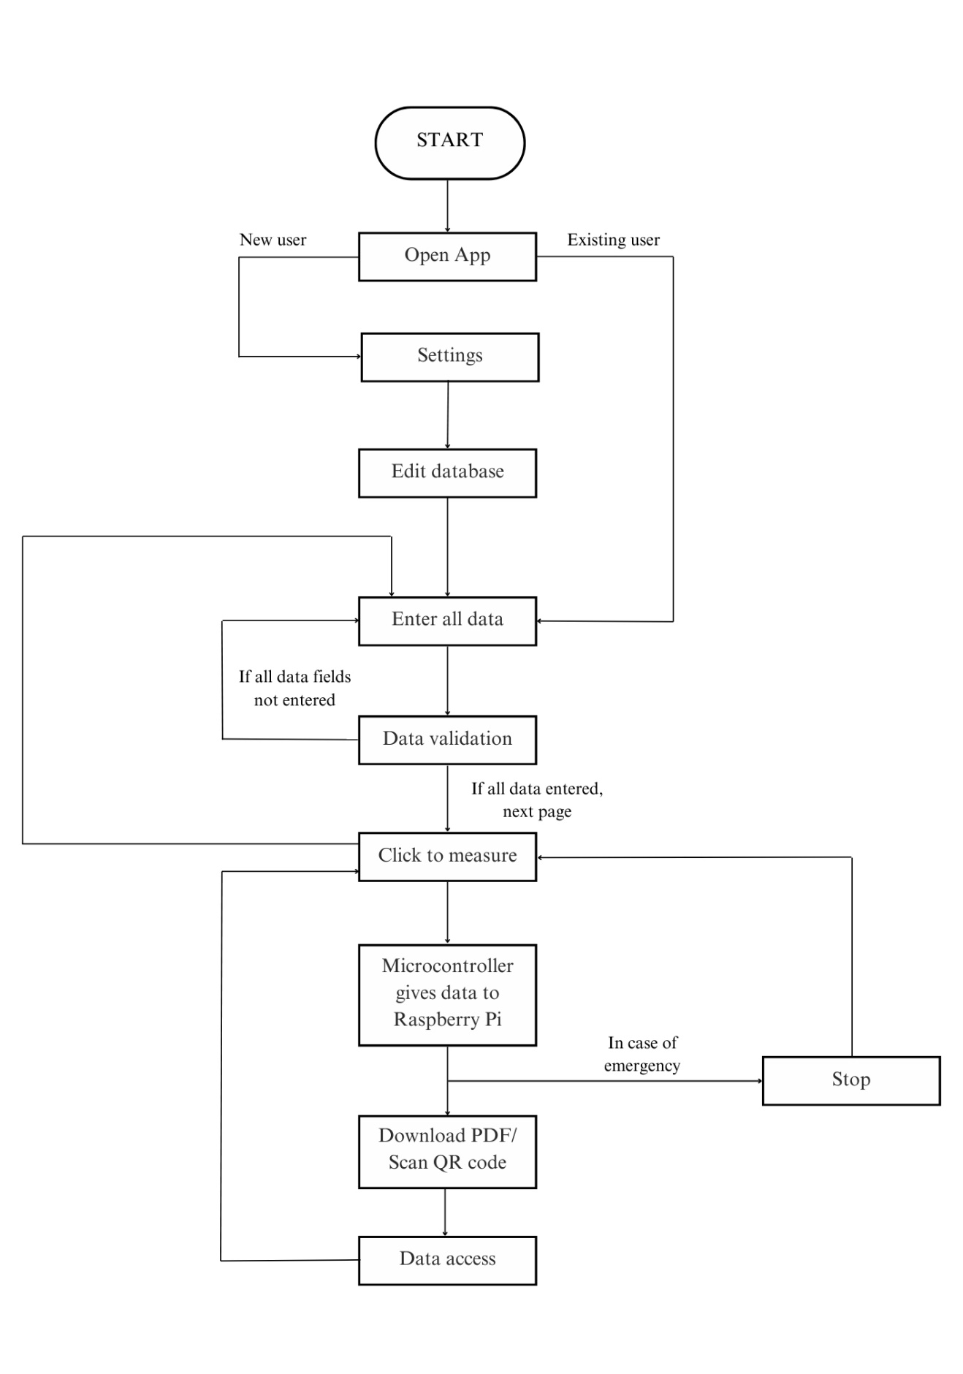
Software Design:

Slide 16
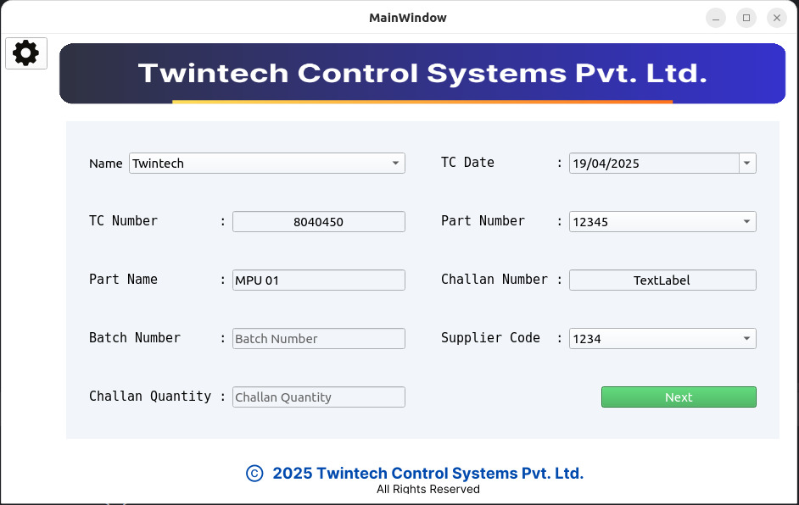
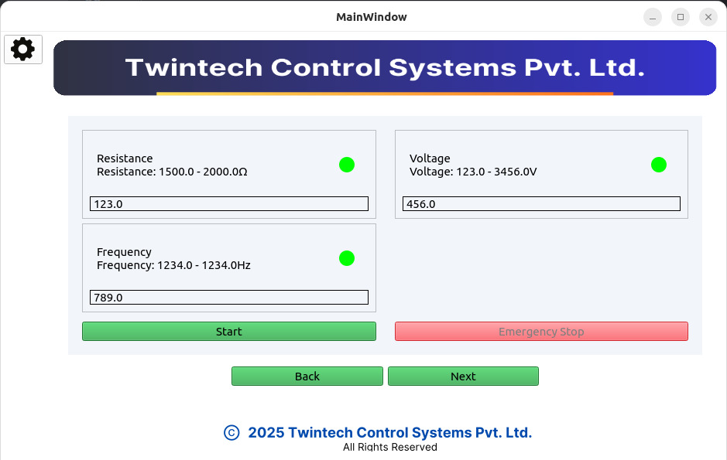
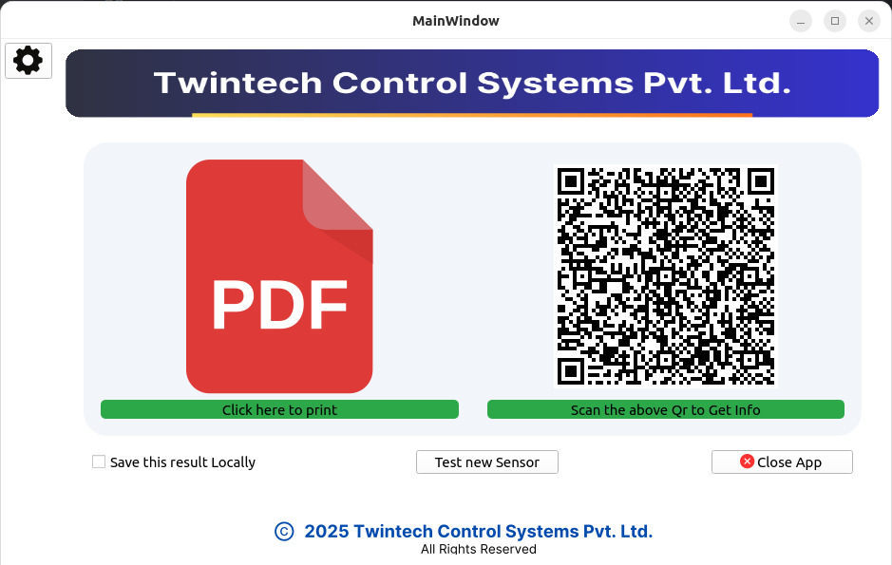
Result (Photo / Audio-Visual / Video Results):

Slide 17
Applications:
The magnetic pick-up sensor system is vital in automotive and industrial domains, especially in diesel engines and Anti-lock Braking Systems (ABS).
Diesel Engines:
It senses crankshaft and camshaft positions, optimizing fuel injection and ignition timing.
Enables accurate engine speed measurement for improved fuel efficiency and emissions control.
Anti-lock Braking Systems (ABS):
Detects wheel speeds, allowing ABS to prevent wheel lock-up during braking.
Assists in traction control and vehicle stability enhancement for safer driving on various road surfaces.

Slide 18
Future Scope:
Integration with IoT: Expanding the system to send data remotely for real-time monitoring and cloud-based analysis.
Advanced Data Analytics: Implementing machine learning algorithms to predict sensor behavior and detect anomalies for predictive maintenance.
Scalability: Adapting the system to test a wider range of sensors and resistive elements with higher precision.
Wireless Testing: Introducing wireless communication modules to make testing more flexible and accessible in remote environments.

Slide 19
Conclusion:
In conclusion, the Magnetic Pick-up Sensor project has made significant advancements in sensor technology, particularly for automotive and industrial applications. The project has developed a highly reliable and versatile sensor system, improving operational efficiency and safety by accurately detecting magnetic fields. Key areas for future enhancement include data analytics, wireless connectivity, and multi-sensor integration, which could further boost its performance. This project marks a valuable contribution to sensor technology, with the potential to drive innovation and improvements in engineering systems, ensuring enhanced reliability and safety in the future.

Slide 20
References:
[1] Ömer ERKAN, Gülay GÜLMEZ, Enis TURHAN and Cem HAYIRLI presented an Active Guarded Wheatstone Bridge for High Resistance Measurements, TÜBTAK Ulusal Metroloji Enstitüsü (UME), P.K. 54, 41470, Gebze-Kocaeli, TURKEY, 2018.
[2] Shixuan Gao, Zhenxiang Yi, Yizhou Ye, Ming Qin and Qing-An Huang presented a self-heated double Wheatstone bridge configuration for a 2-D wind sensor, 2018.
[3] Dingsong Jiang, Zhihong Lu, Mingming Chen,and Jianzhong Yang presented the tunneling magnetoresistance (TMR) magnetic sensor, School of Engineering and Technology, China University of Geosciences (Beijing), Beijing, China, 2021.
[4] Brian Miranda, José Luis Casais, Marcos E. Bierzychudek, Harold Parks† and Branislav Djokic presented a study of the voltage dependence of a high DC voltage divider, Instituto Nacional de Tecnología Industrial, Buenos Aires, Argentina, 2020.
[5] Yeejung Kim, Taehoon Kim, Hoon Kim, Sunghun Kim, and Youngnam Han presented A Threshold-Based Relay Switching Protocol for Enhanced Capacity and Resource Efficiency, 2011.
[6] Chong Zhao and Zhaoxi Hua presented PID speed regulation system based on a STM32 microcontroller, 2022.
[7] C. W. Huang, W. T. Hsu, G. J. Cai and Q.J. Xiao presented digital controlled high-voltage DC power supply based on STM-32 microcontroller, 2021.
[8] Petr Prochazka, Ivo Pazdera, Jan Miklas and Radoslav Cipin presented Analysis of Power Transistor Switching Process, Department of Power Electrical and Electronic Engineering, Faculty of Electrical Engineering and Communication, Brno University of Technology Brno, Czech Republic, 2019.
[9] Andrey A. Antonov, Maksim S. Karpovich, Yuri D. Kozlyaev, Yuri E. Semenov and Vladislav Yu. Vasilyev presented Integrated Circuit Test Chip for Power Transistor Operation in AC/DC Power Supply Units in Zero Voltage Switching Mode, SibIS LLC, Novosibirsk, Russia, 2014.
[10] Yi-Chen Lee, Ching-Min Lee presented develop a controlling unit using Raspberry Pi, 2021.
[11] Shubham Raut, Vishal Talekar and Aniket Govardhan presented Digital Electronic Voting Machine (DEVM), 2021.

